Slide 1
Student Performance Monitoring System 4.0
CSE303 Project Presentation
Done by
Team Failure Databees
1921629 | Tahfizul Hasan Zihan
1930109 | Avijit Saha
1920408 | S.M Farhan Shariar
2021604 | Suparna Sarker Sapna
1920153 | Afif Bin Arfan
1921678 | Md. Safiul Mujnebin

Slide 2
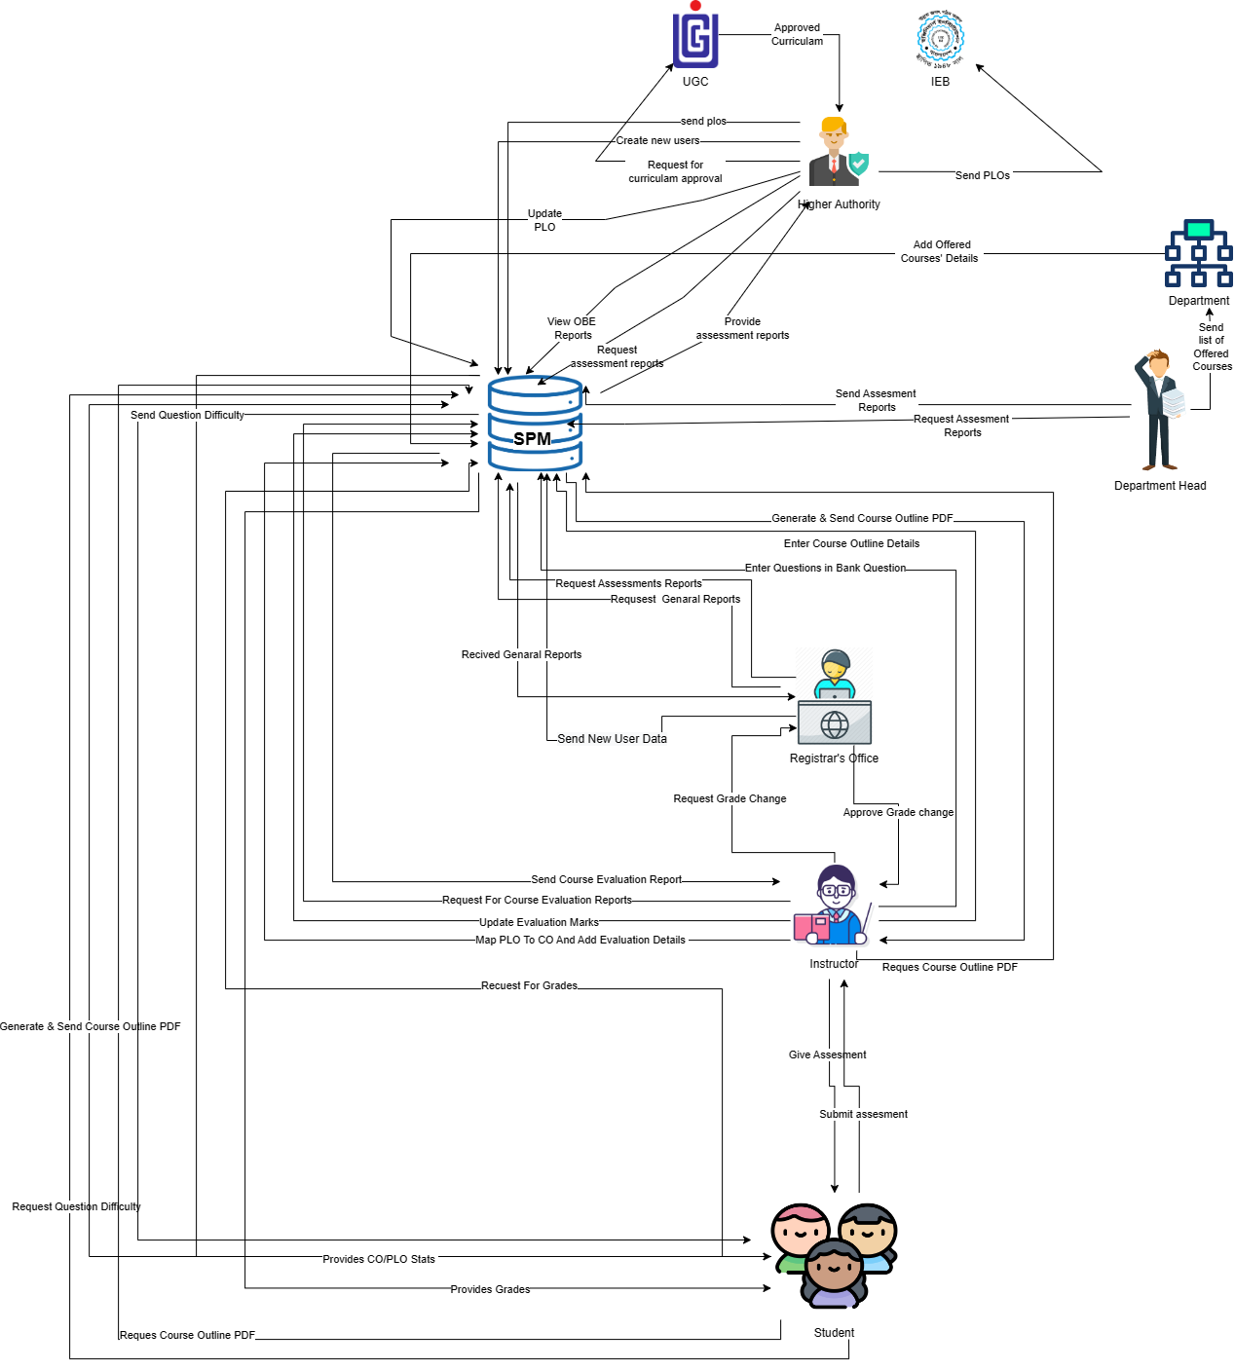
Rich Picture (AS-IS)

Slide 3
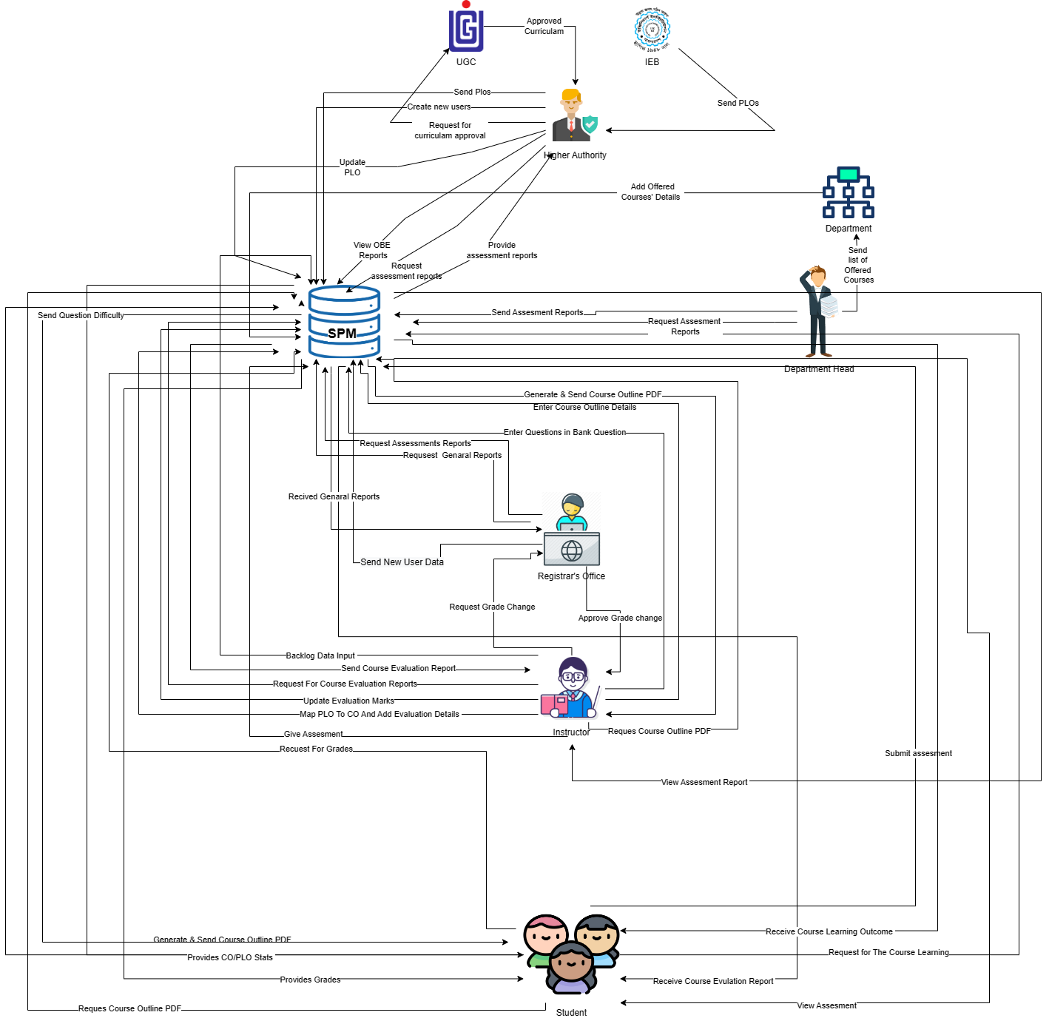
Rich Picture (TO-BE)

Slide 4
EXISTING PROBLEMS & ANALYSIS OF THE PROBLEM
Process Name | Existing System Problems | Proposed Solution
Developing a Customized Dashboard System | All users share the same dashboard. There is no feature allocation or role changes in each dashboard. Each user is not supposed to have every available feature. | Providing access to features and functionalities based on user roles. Developing a dynamic dashboard that only displays features and functionalities based on user roles.
Implementing Web Application Security Controls | All users can access every feature. Whether the webpage is linked or not, each user can access every page just by hitting URL. | Implementing authentication using PHP sessions, cookies, or other methods.
Implementing a Backlog Record Management System. | Backlogged records were unable to store. | Creating a new form to collect backlogged records of student's grade or CLO records and Show the Backlogged Data Table.

Slide 5
EERD

Slide 6
Relational Schema

Slide 7
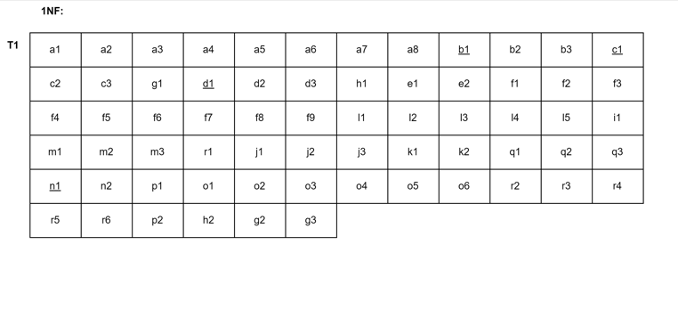
Normalization

Slide 8
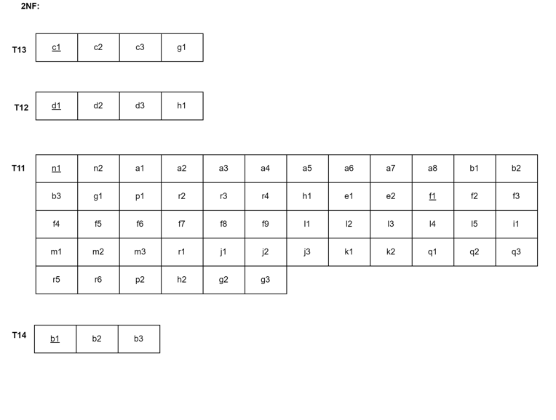
Normalization (continued)

Slide 9
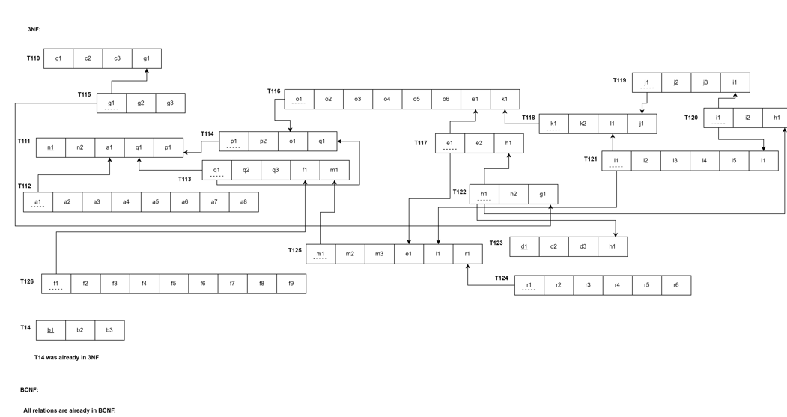
Normalization (continued)

Slide 10
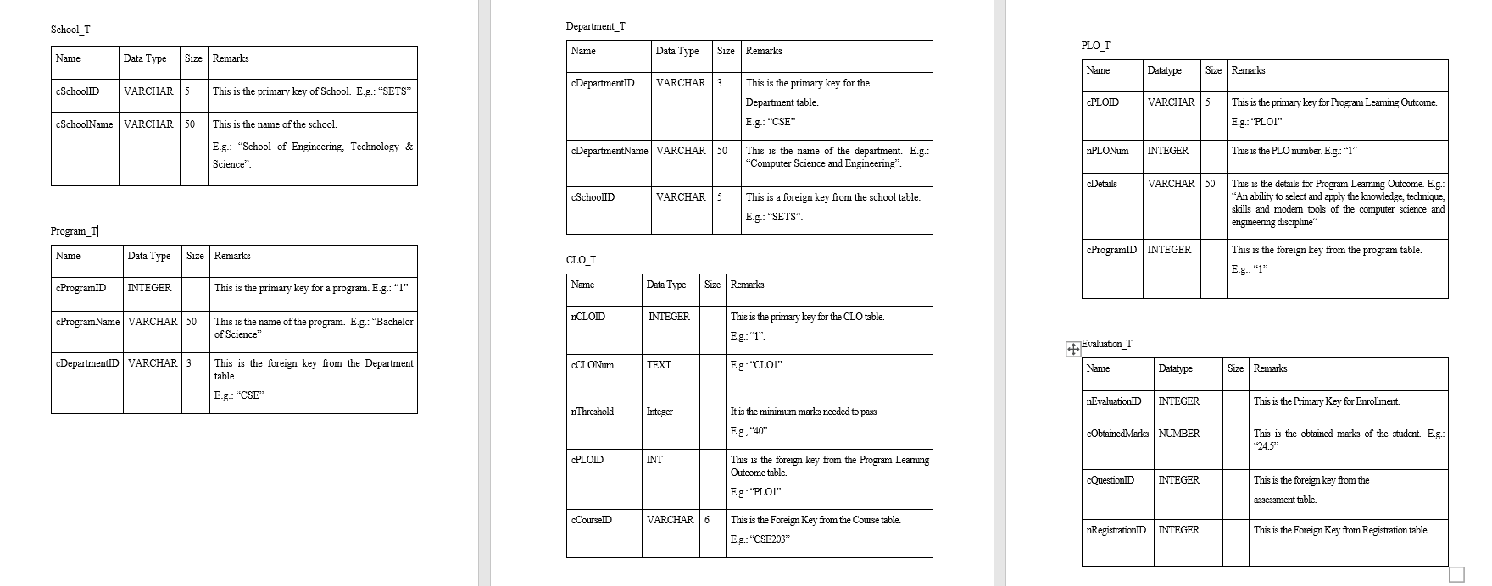
Data Dictionary

Slide 11
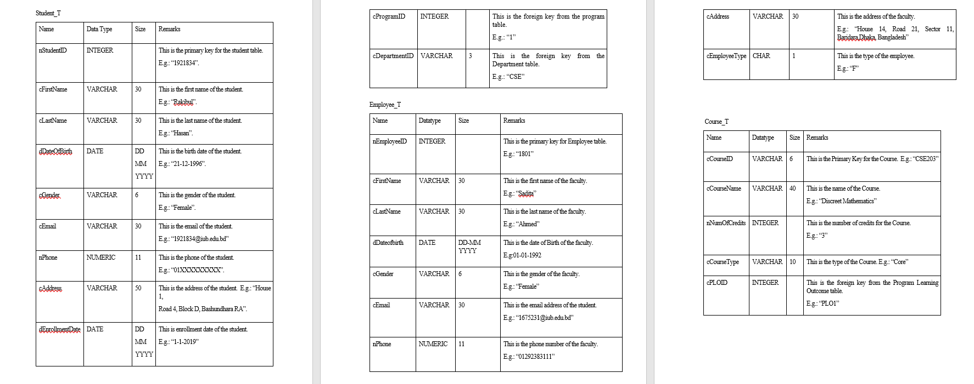
Data Dictionary (continued)

Slide 12
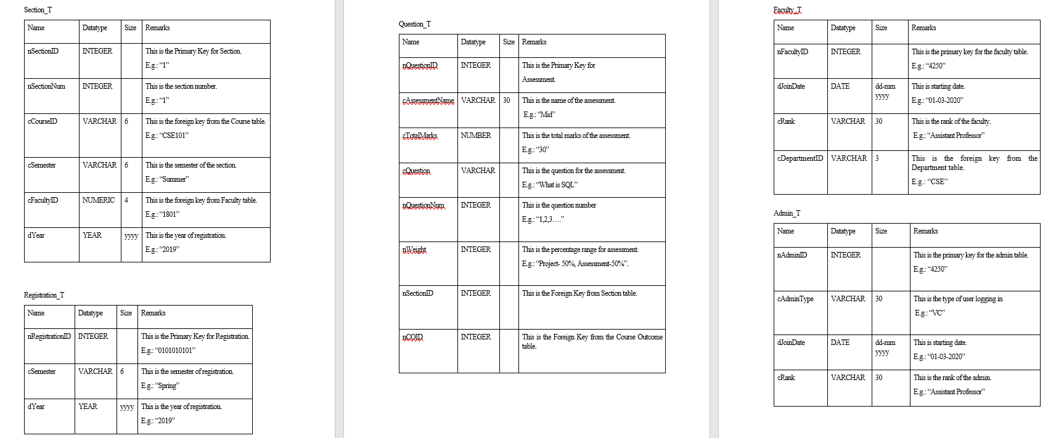
Data Dictionary(continued)

Slide 13
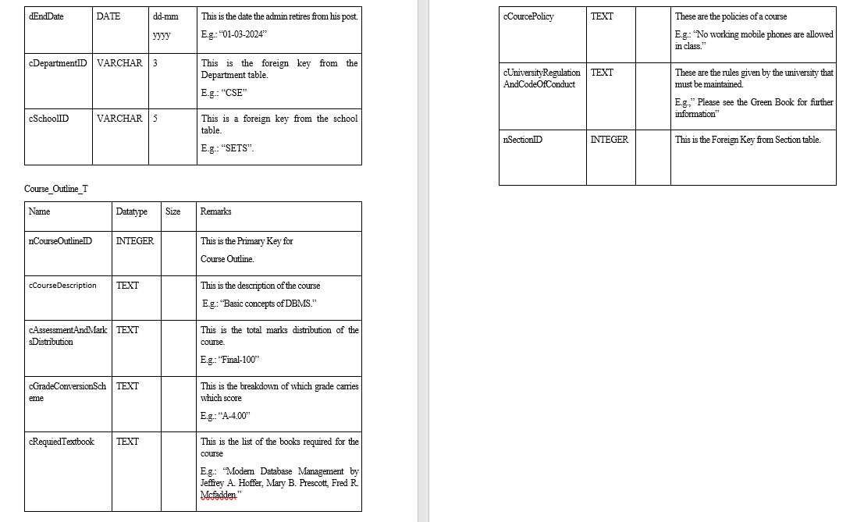
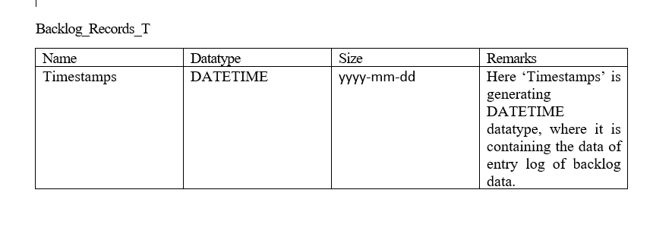
Data Dictionary(continued)

Slide 14
Thank You

